Slide 1
CANSKATE PARENT MEETING

Slide 2
Welcome to Canskate
Are you new to canskate?
If you are returning, we have some updated information for you as well.
Let us introduce you to your club President, Chanda Bissett.
Laurie Godfrey is our club administrator, who is the one e-mailing you (sometimes at odd hours around her work schedule!)

Slide 3
Your Account
To find a lot of information you need to be logged into your account
Once logged in go to the upper right corner where you will see your name
Click on my account from the drop down when you hover over your name
Once in “my account” you will have a menu bar specifically for you.
THE CALENDAR tab in your account
will show all your registered skating days, events etc. A non-skating day may show a tournament instead of your regular skating time. These were pre-scheduled. You were not charged for these days in your registration fee, there are no make-up days.
This is the best “go-to” as it shows your registered session times. It the event of any changes, it will show here first.
There are other items such as evaluations, achievements, copies of your invoices…explore your account or also go to our home page under “Canskate & Powerskate Information” with a drop down menu of detailed info.

Slide 4
E-Mail
Did you get your Welcome to Canskate e-mail?
To assure you receive important correspondence make sure you have us marked as safe and in your address book. Check your junk mail if you have not heard from us in a long time. We avoid sending frequent emails however there are often events or possible closures that we wish to reach you about.
To confirm you have “opted in” to all emails to receive registration notices. This can be checked when in your account on the “MESSAGES” tab on your menu bar

Slide 5
Canskate Events
There are additional events for our Canskaters that require registering for.
In December we have:
The Holiday Performance – A Food Bank Drive – there is no cost to register but there are limited spaces as it’s a short performance so register early to be a part of the holiday show. It is a follow the leader type performance so there are no additional practices.
The Canskate Merit Event – This event is part of the long-term development within Skate Canada. It is a time to celebrate and let your skaters shine and show their skills they have been learning. Each skater will be assessed and receive feedback, a certificate and ribbon. It’s fun and a great celebration of their achievements. You need to register to be in it and there is a $5 charge to help off-set costs.
Part 2 Programming
Will open in November for registration.
There will also be our Ice Gala in March (and another Canskate Merit Event). We host the Gala every two years. This is a larger event and has a $5 charge to help offset the costs.

Slide 6
Notices
Along with sending email we also have a bulletin board in the lobby where we will post updated information, special events and more. Check it out once-in-a-while for new information.
Closures – in the event of storms or unforeseen closures, we will post on our website as well as send you an email. We normally only close if the facility is closed. Therefor if you see from a community posting that the arena is closed, then so are we. There is the off-chance if our administrator does not have power, they will not be able to email you. Please don’t call the arena as they are not part of our operation for detailed info.
THANKSGIVING MONDAY there is NO SKATING. The rest of the week-end programs run as usual.

Slide 7
On Ice Specifics
Your skaters name tag will have a colour indicating their group
This colour does NOT reflect what stage of canskate achievement they have
The groupings on the ice are to maintain coach ratio and put children together that are either at the same level or working on similar skills.
Skaters may get moved from time-to-time to another group for best practice
If they skate more than one day a week, they may have a different colour group on each day dependant on the balance of skaters on the ice for that day.
No matter which group a skater is in, they will ALWAYS work at their personal level.

Slide 8
Coaching Staff
There will be up to four professional NCCP certified coaches on the ice.
They usually will be wearing a red coat, with “ coach” on the back
Assisting them are our Program Assistants.
Program Assistants are from our Starskate Program. They are volunteers who have undergone program assistant training.
They will be wearing blue jackets and red hats. They are not required to wear helmets based on their skating level and insurance coverage. So, if you see a young person out there without a helmet, they are a program assistant. All CANSKATERS MUST WEAR A CSA APPROVED HOCKEY STYLE HELMET.

Slide 9
Healthy Kids! Active Kids! Fundraiser
This is not mandatory however we are asking all Canskaters and Powerskaters to consider purchasing at least one item.
We have been hit hard with increased operating expenses from all areas this season ie ice costs, insurance, coaching, supplies etc and we DO NOT want to pass these increases off to you by increasing registration fees. Sports are expensive enough for families and we would rather put food on your tables than increase fees.
The fundraiser is a “surf and turf” this year with items from Steerman’s Quality Meats and mussels from PEI Aqua Farms.
If you want to fill your freezers and you purchase more than 10 items, you will receive a credit on your personal account as well as helping the club overall.
Extra order forms are available. We will also email out a copy for printing or using digitally.

Slide 10
Volunteers
We are always looking for volunteers
This can be during your scheduled skating time only or at special events or if you are really keen, we always could use someone new on the board.
During your skating time we are looking for those that would be willing to assist with:
Handing out colouring sheets or other treats
Assisting coaches, for example: if they are trying to locate a parent
Monitoring the entrance/exit door so that it does not get congested with parents
Assist coaches (from the off-ice side of the door) getting skaters onto the ice
Special Events
Notices will go out for help with our Holiday Performance, Merit Days and Ice Gala

Slide 11
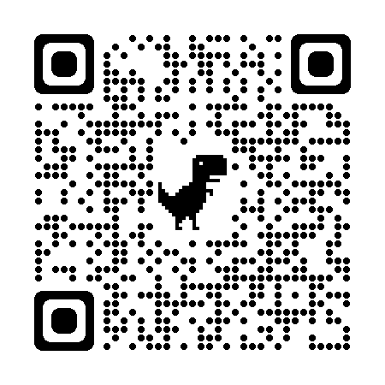
Club Apparel
We have a store available through Allstar Cresting
There are t-shirts, hoodies, outdoor jackets and more – Get in the spirit with quality merchandise. 10% goes to the club.
Here at the club, we also have mittens/gloves and a limited supply of skate guards for sale
Club competition/practice jackets are orderable through the club. Reach out to us at office@sherwoodparkdaleskatingclub.com if you are looking for an on-ice jacket. You can follow this link to our Allstar Store. This is also posted on our bulletin board.

